Slide 1
Sales & Financial Performance Dashboard
Analysing sales, profit, and growth trends across segments and regions
Data Analyst Internship - Task 4

Slide 2
Objective & Dataset
Objective:
Design an interactive Power BI dashboard for stakeholders, highlighting sales, profit, and growth trends.
Dataset:
Microsoft Financial Sample (Excel).
Scope:
• Clean & preprocess dataset
• Create KPIs (Sales, Profit, Profit Margin)
• Perform time-series and category analysis

Slide 3
Key KPIs
• Total Sales
• Total Profit
• Profit Margin %
• YoY Growth (if included)

Slide 4
Dashboard Overview
The Power BI dashboard includes:
• Time-series analysis (Sales over Time)
• Category analysis (Bar/Tree Map)
• Distribution analysis (Donut chart)
• Detailed breakdown (Table/Matrix)

Slide 5
Insights & Recommendations
Key Insights:
• Sales show consistent growth over time
• Certain products/segments contribute most to profit
• High discounts reduce overall profitability
Recommendations:
• Focus marketing on high-margin products
• Optimise discount strategies to balance sales and profit

Slide 6
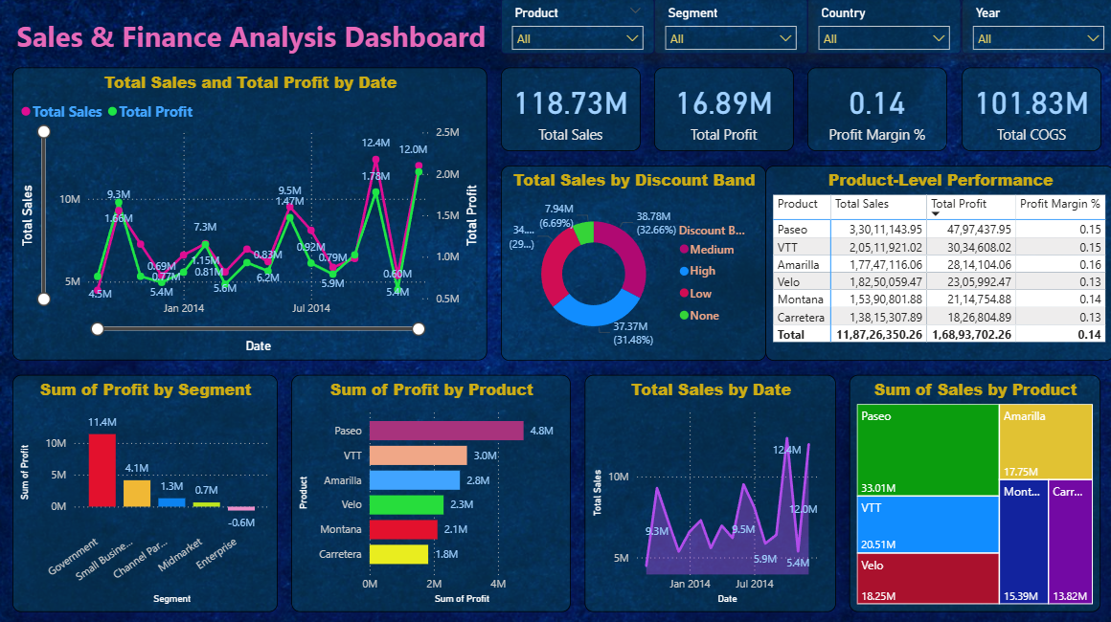
Dashboard Screenshot

